Slide 1
IBM University Engagement Project Submission
“Exploring the Power of Machine Learning with IBM Cloud”

Slide 2
Project Tile – Network Intrusion Detection
Domain of Project – Security
Student Name | Email ID | Mobile number [WhatsApp]
SOFIA TM | kuramaragaisa@gmail.com | 7598857175

Slide 3
Problem statement No.40
Problem Statement: Network Intrusion Detection using Machine Learning
Network Intrusion Detection Systems (NIDS) are a critical line of defense for securing communication networks against cyber-attacks. As network traffic grows in volume and complexity, manually monitoring for malicious activity becomes impractical, and delayed detection can allow attacks such as denial-of-service, scanning, and unauthorized access attempts to cause significant damage before they are noticed. Your task is to design, build, and deploy a machine learning-based system that can analyze live network traffic and classify each connection as Normal or Anomalous in real time, using IBM Cloud Lite services for training and deployment. The goal is to create a working early-warning tool that captures real traffic, reconstructs the relevant connection features on the fly, and provides operators with an immediate classification and a recommended mitigation action — enabling faster, more reliable detection of malicious network activity than manual monitoring alone. While network attacks vary widely in type — including denial-of-service, scanning, and unauthorized access attempts — this project implements binary anomaly detection (Normal vs. Anomaly) based on the dataset explicitly provided for the task.

Slide 4
Proposed Solution -
(IBM Watson Studio – AutoAI):
We propose an AI-powered Network Intrusion Detection System using IBM Watson Studio and AutoAI.
Live network traffic will be captured locally and converted into connection-level feature records (duration, protocol, service, byte counts, connection rates, and error rates) using a custom flow aggregator, mirroring the NSL-KDD feature schema.
AutoAI will automatically perform data preprocessing, algorithm selection, feature engineering, and hyperparameter optimization on the training dataset.
Multiple classification pipelines will be generated and evaluated to identify the best-performing model for distinguishing normal traffic from anomalous traffic.
The selected model will be deployed as a live REST scoring endpoint via Watson Machine Learning, enabling real-time classification of connections as they are captured — with each anomaly paired with a recommended mitigation action for the operator.

Slide 5
Technology Used
IBM Cloud – It provides the infrastructure to build, deploy, and scale the Nutrition Agent efficiently. IBM Cloud enables a reliable, secure, and scalable environment for deploying the Nutrion agent
ML Algorithm/Model Used: Snap Random Forest Classifier (Batched Tree Ensemble), selected automatically by AutoAI from the generated pipeline leaderboard
Accuracy Obtained: 99.6% (cross-validated, from AutoAI's pipeline leaderboard).
Enhancements and Hyperparameter Tuning: HPO-1, Feature Engineering (FE), HPO-2, and Batching, as applied by AutoAI to the top-ranked pipeline
Python : for network loging
streamlit: for dashboard

Slide 6
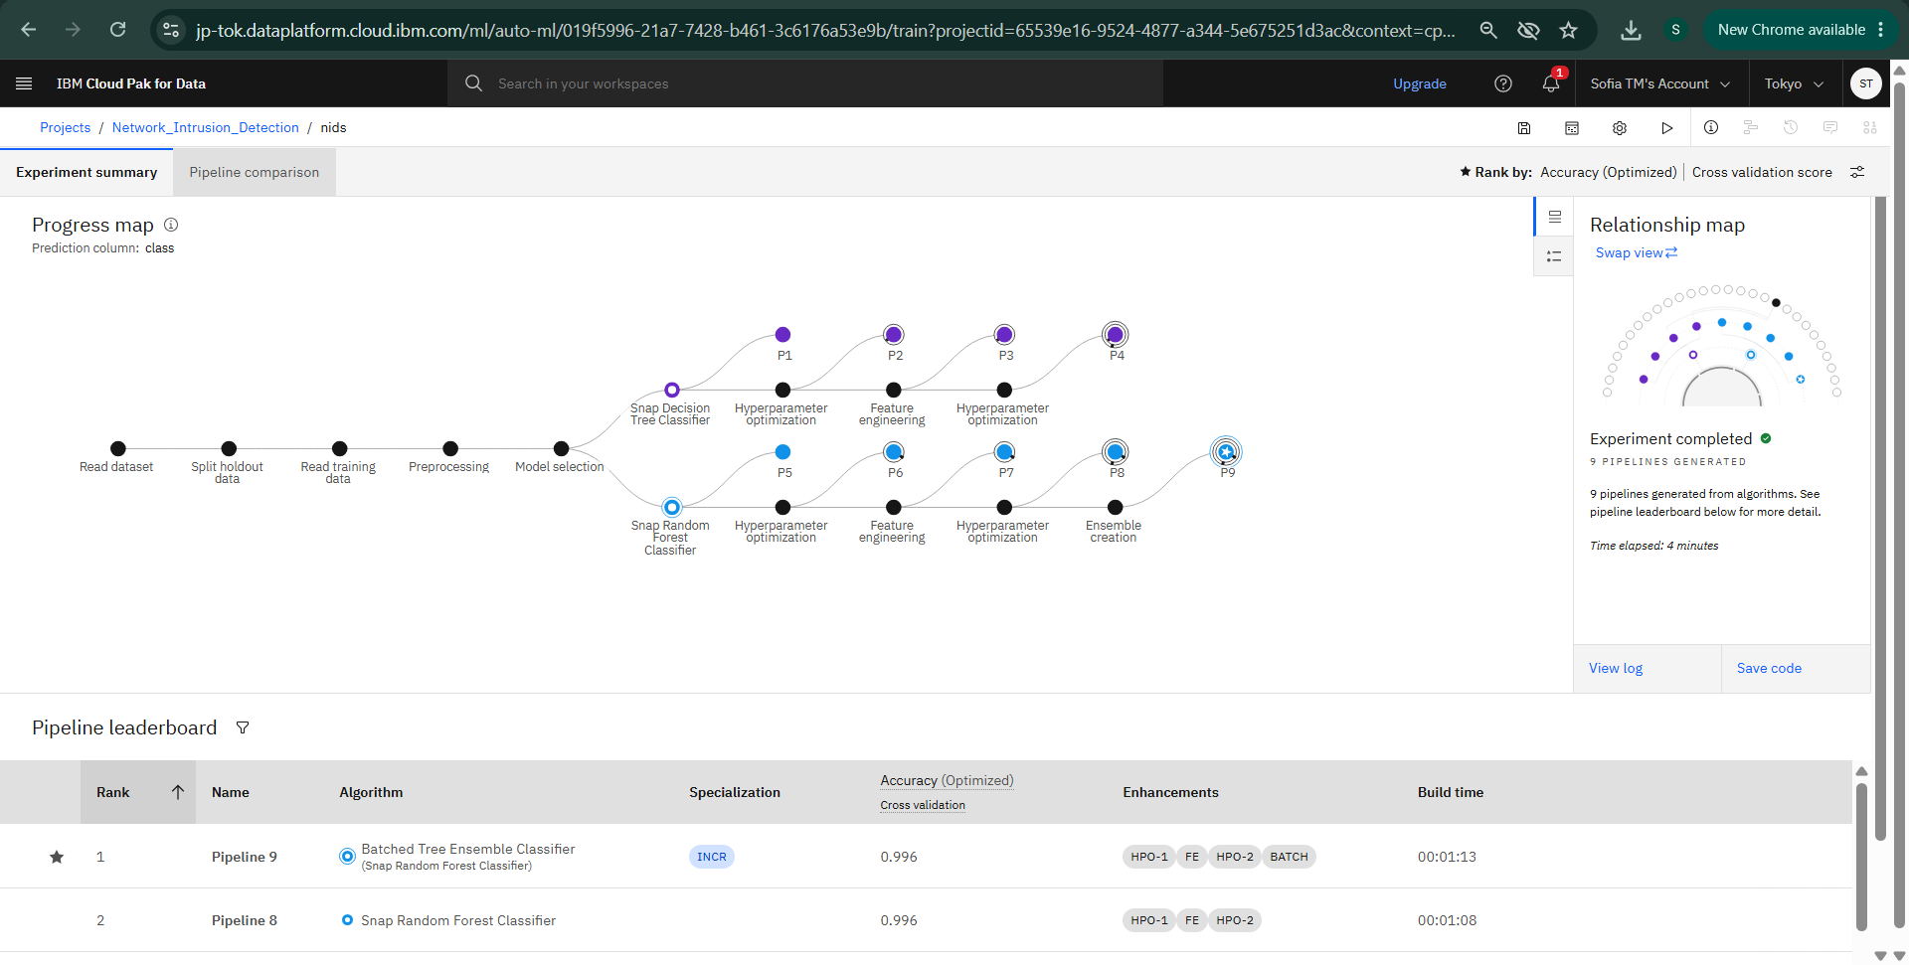
Training Screenshots-

Slide 7
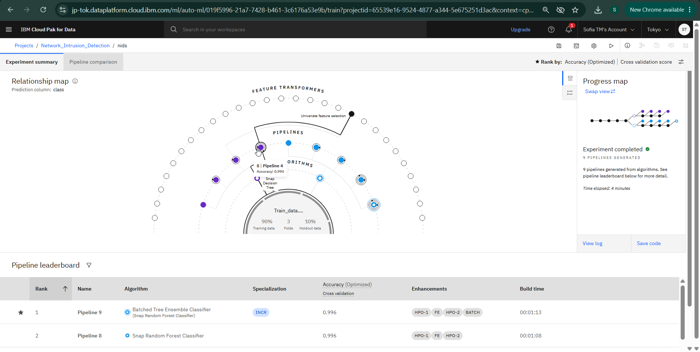

Slide 8
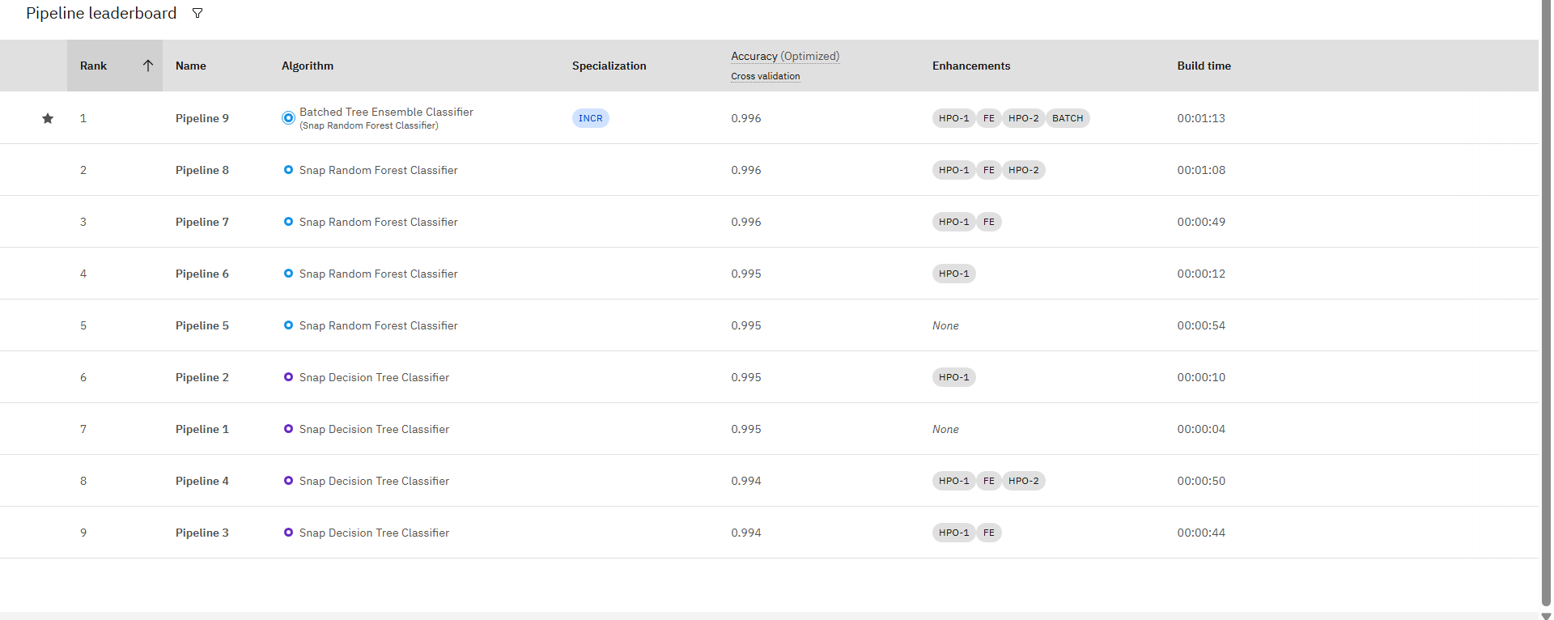
Best Model Screenshot:

Slide 9
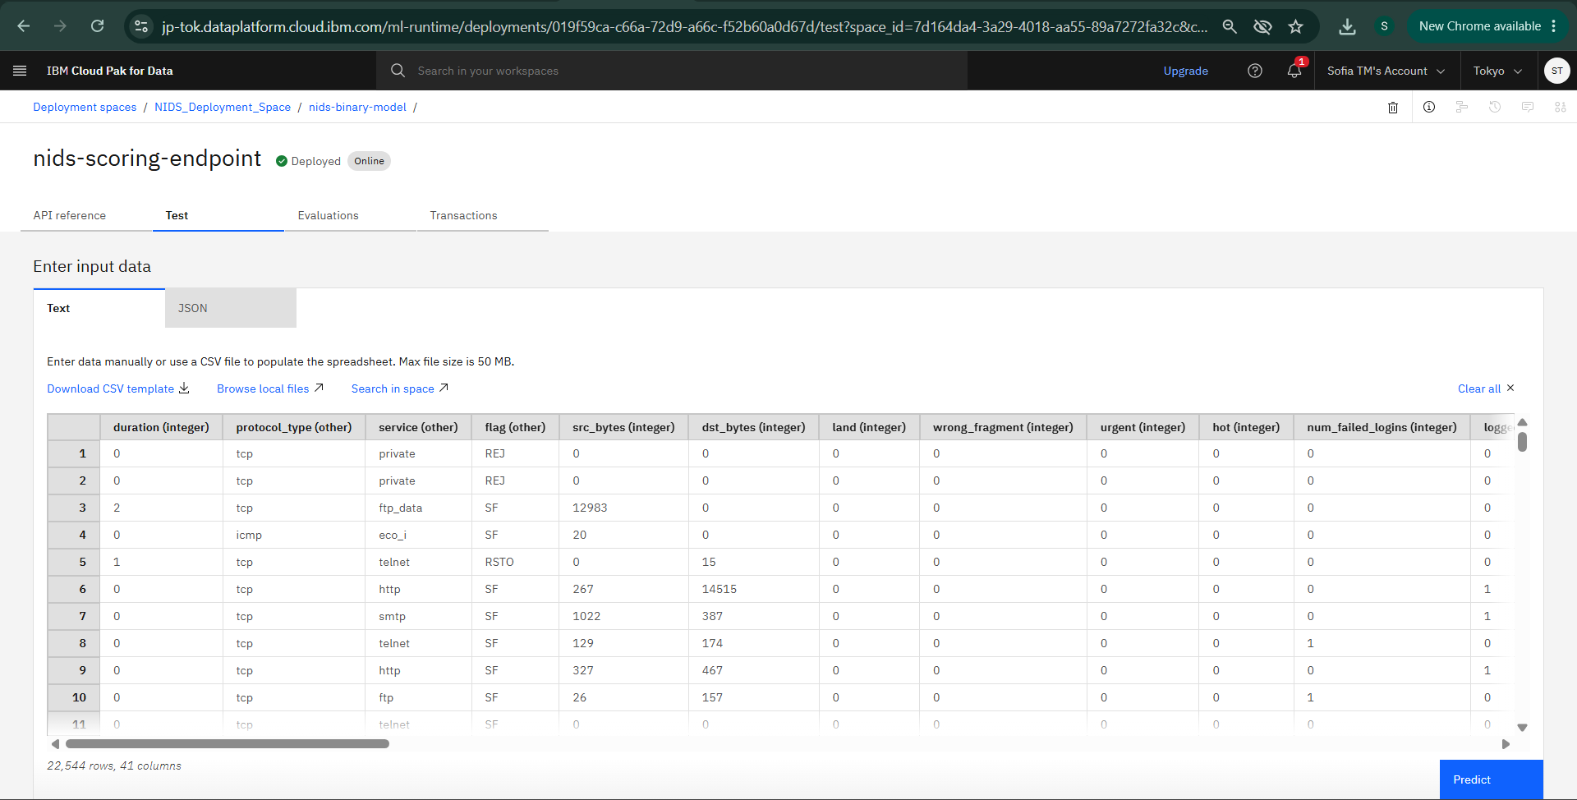
Testing Screenshot:

Slide 10
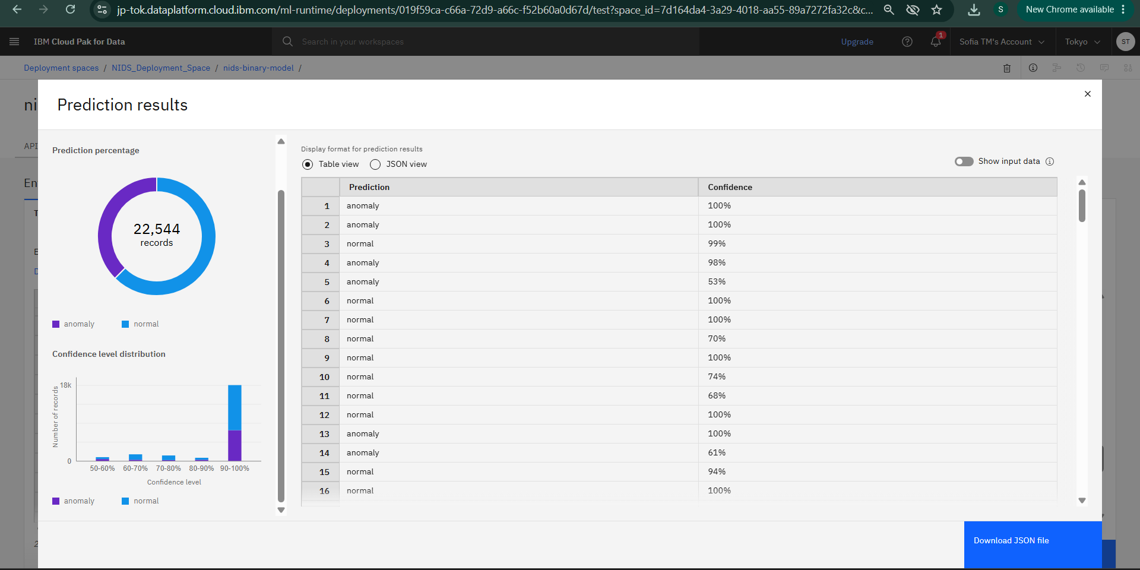
Testing Screenshot:

Slide 11
Novelty and Uniqueness
The solution automates network intrusion detection by classifying live traffic in real time, removing the need for manual, continuous monitoring by a human operator.
It uses IBM Watson Studio AutoAI to automatically discover the best-performing classification model without manually coding or tuning individual algorithms.
A custom flow aggregator reconstructs connection-level features directly from raw live packets, enabling detection on real captured traffic rather than only static, pre-recorded test records.
Each detected anomaly is paired with a rule-based heuristic layer that estimates the likely attack pattern (e.g. scanning-like or flood-like behavior), giving operators additional context beyond a simple normal/anomaly label.
The system provides a live operator dashboard with real-time alerts and clear, human-reviewed mitigation recommendations — ensuring consistent, immediate response guidance rather than delayed manual log review.

Slide 12
Git Hub Link
https://github.com/Sofia6002/Network-intrusion-detection-system_IBM_CLOUD
·
·
·

Slide 13
Future Scope
The system can be integrated with government portals to automate the end-to-end NSAP application verification process.
Additional welfare schemes can be included, enabling a unified AI-based beneficiary recommendation platform.
Real-time data integration with Aadhaar and other government databases can improve eligibility validation and fraud detection.
Advanced AI models in IBM watsonx.ai can be used to continuously improve prediction accuracy as new data becomes available.
The solution can be scaled nationwide to support faster, transparent, and data-driven welfare distribution across multiple social security programs
·
·
·

Slide 14
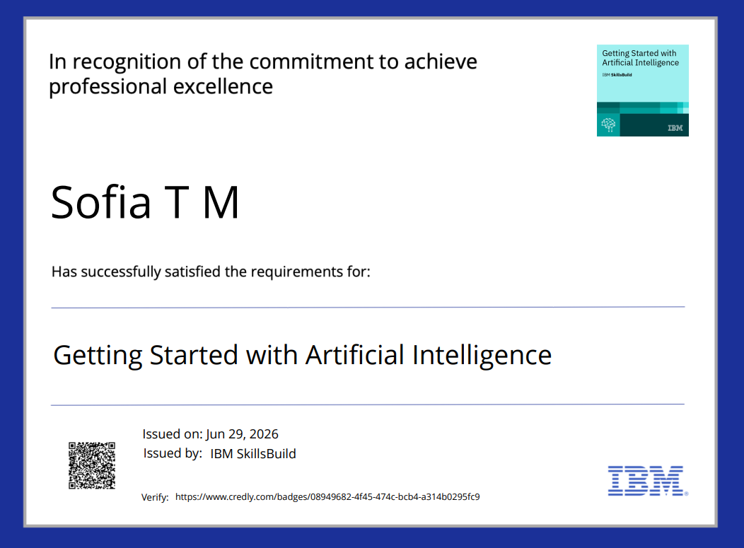
Certificates Earned:
Getting Started with Artificial Intelligence

Slide 15
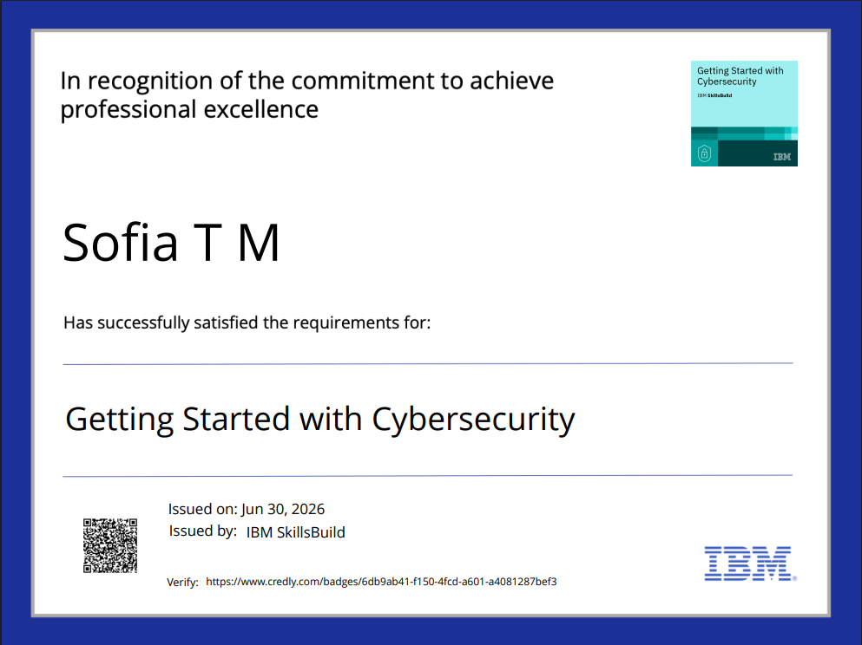
Certificates Earned:
Getting Started with Cybersecurity (Earn a credential!)

Slide 16

Certificates Earned:
Level Up Cybersecurity with Generative AI

Slide 17
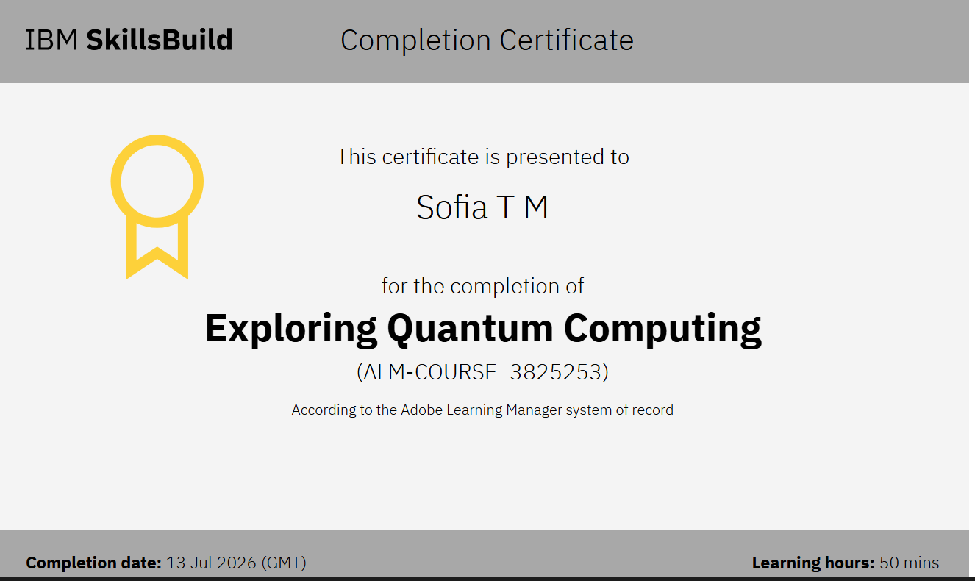
Exploring Quantum Computing

Slide 18
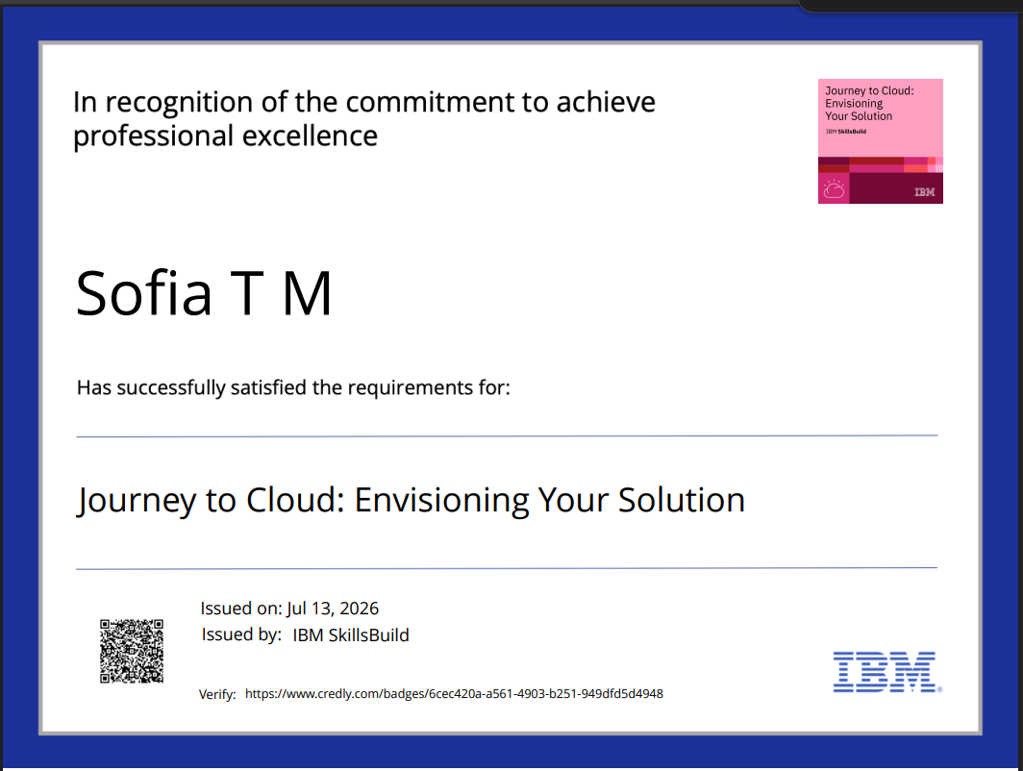
Certificates Earned:
Journey to Cloud: Envisioning Your Solution

Slide 19
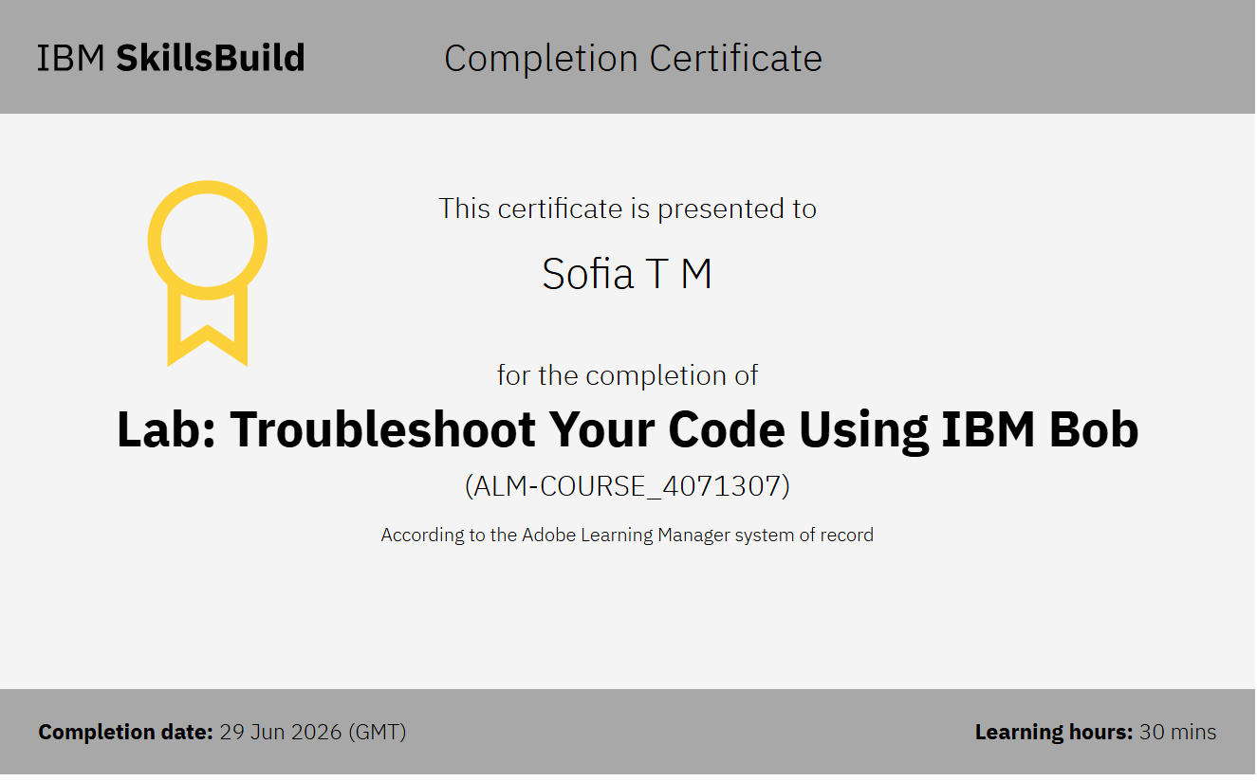
Certificates Earned:​
Add your IBM BOB Certificate

Slide 20


